Slide 1
The Simple
Home Office Solution
DISCOVER
2022

Slide 2
SECURE
Set Up Home Office in Minutes.
2
7
No need for extra hardware investments or high learning curves.
Enable employees to connect to their office PC from anywhere!
USER FRIENDLY
ECONOMIC

Slide 3
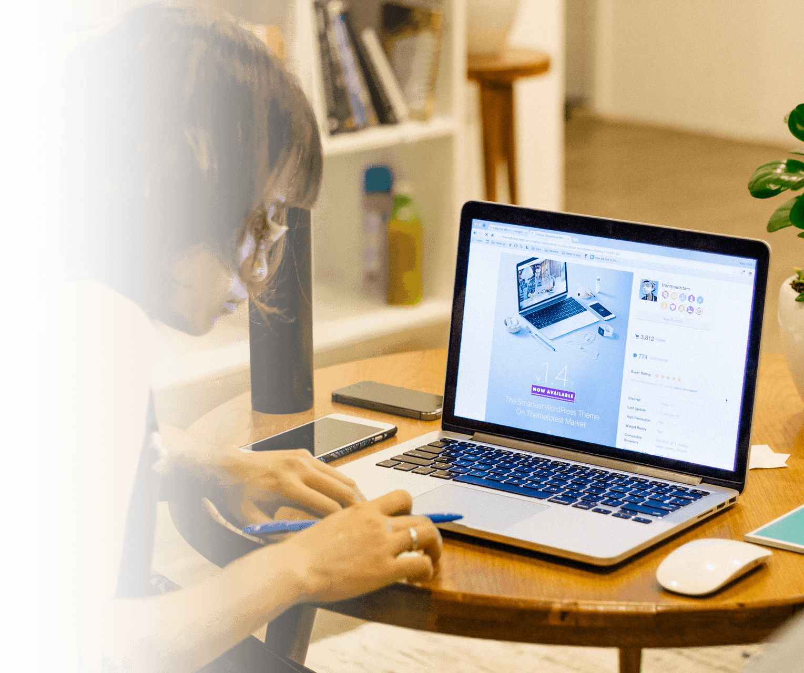
Remote Desktop Access from the Home PC to the Office Workstation
3
Give instant access to a full work environment
7
Remote Desktop Connection
Intuitive AdminTool
Customizable Web Portal
Session Capture
Universal Printer

Slide 4
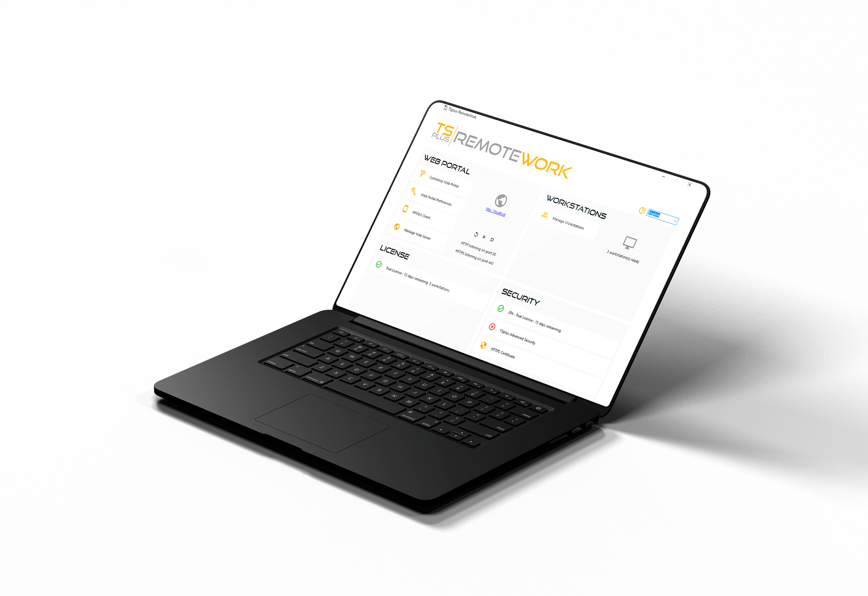
Keep Productivity High with a Familiar Working Environment
4
QUICK INSTALLATION
7
Easy Set up and Configuration
Simple Management Interface
No Windows Server Roles Required

Slide 5
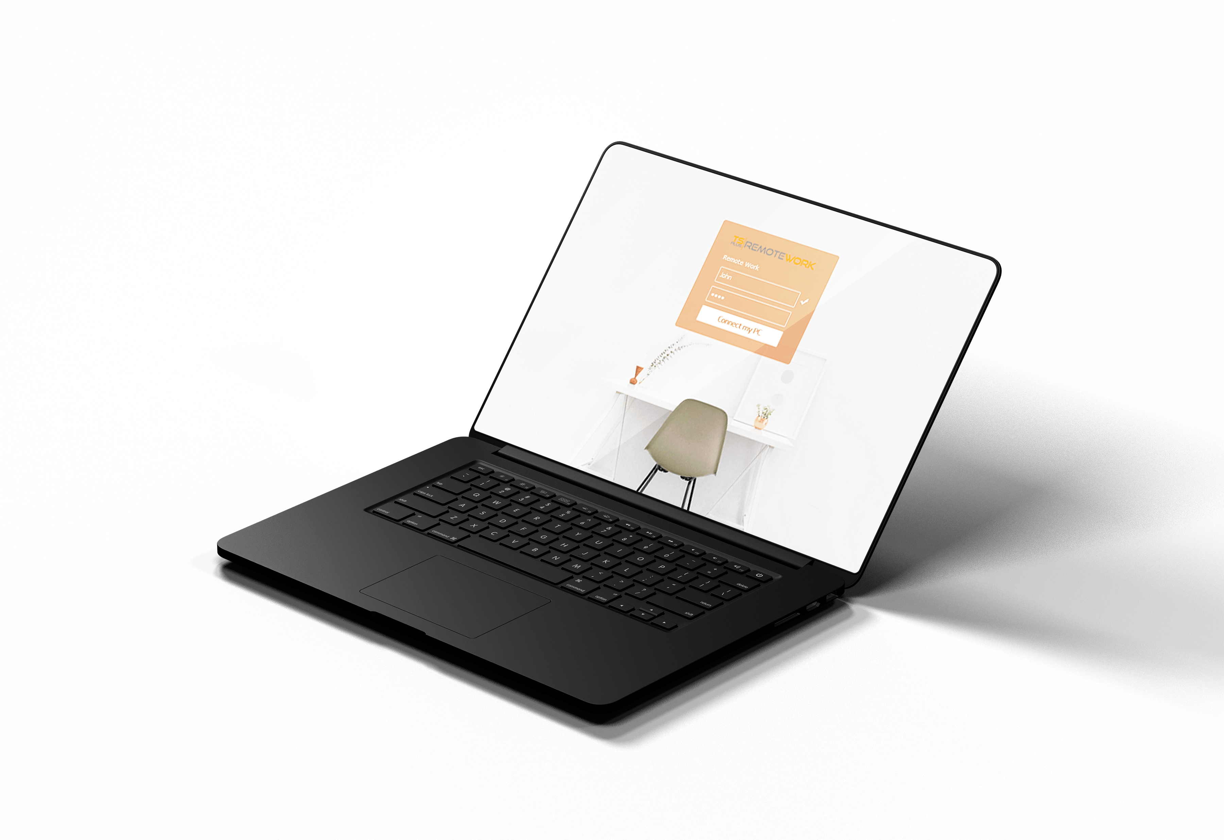
Keep Productivity High with a Familiar Working Environment
4
SIMPLE DEPLOYMENT
7
Built-in Connection Broker
Single Sign-on Web Portal
Compatible with Any Web Browser

Slide 6
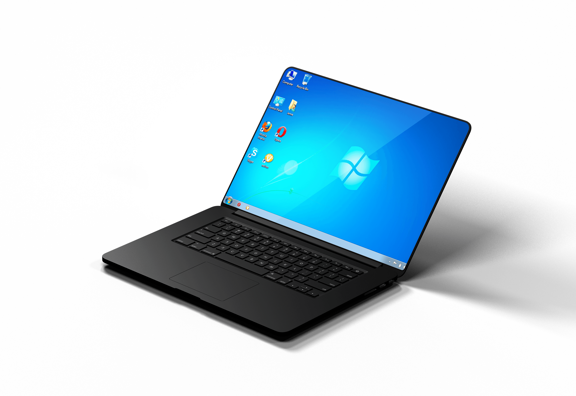
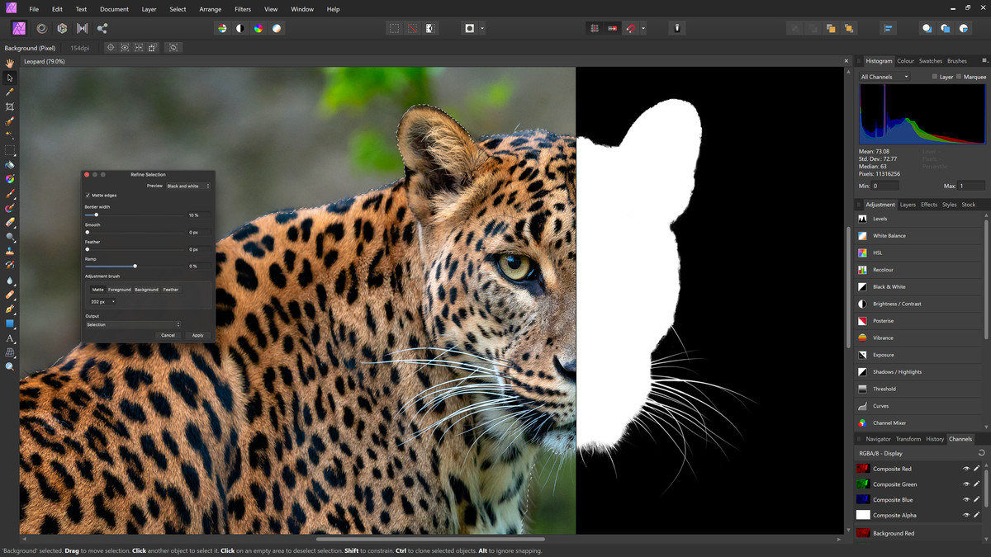
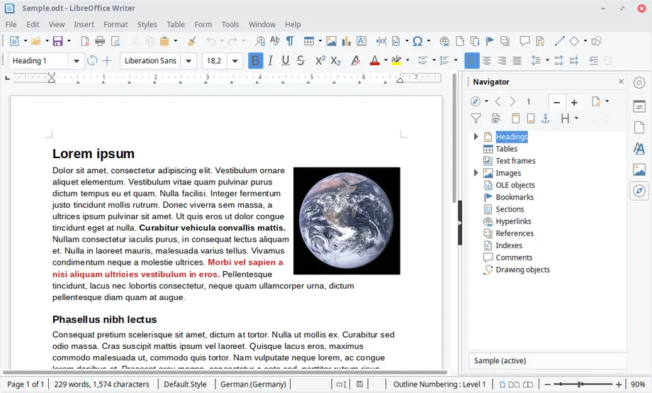
Keep Productivity High with a Familiar Working Environment
4
FAMILIAR ENVIRONMENT
7
Direct Connection to Office PC
Open on the Same Session
No Training Needed

Slide 7
Make The Home Office Safe for Everyone
No Third Party Server. Keep Control of your Connections!
5
7
On-Premise Installation
Built-in Gateway
Two Factor Authentication (optional)
Compatible with TSplus Advanced Security

Slide 8
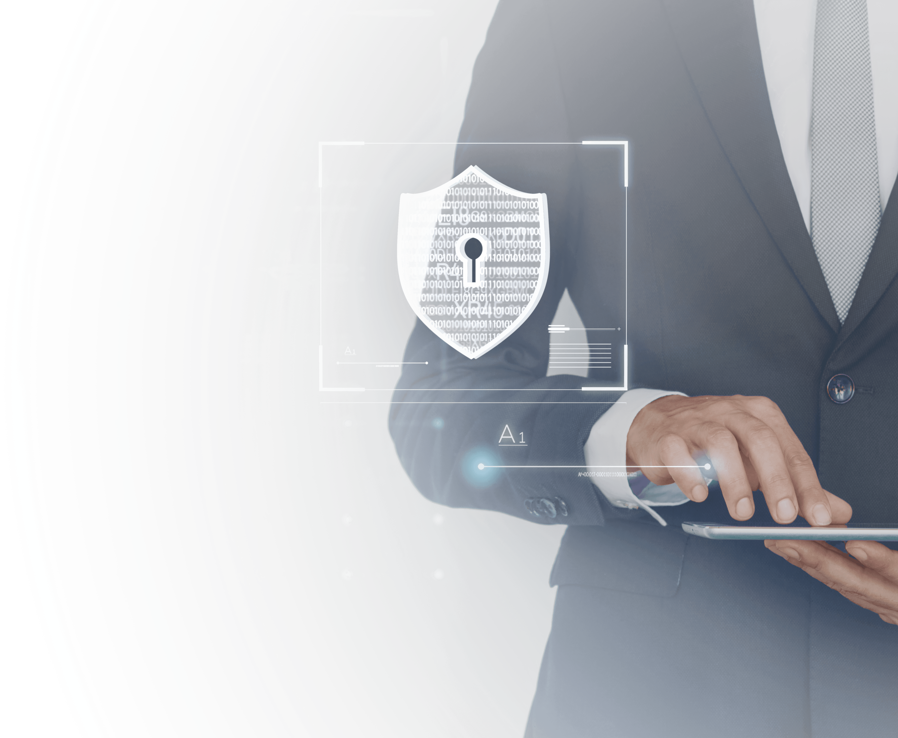
SECURE
Making The Home Office Safe for Everyone
No third party server. Keep control of your connections!
5
7
On-Premise Installation
Built-in Gateway
Free SSL Certificate
Two Factor Authentication (optional)
Compatible with TSplus Advanced Security

Slide 9
YOUR PC AT HOME
The TSplus Difference: Easily Manage your Own Connection Broker and Web Server
DMZ
6
7
Connection Broker
Self-hosted on your local server or private cloud for top security
CORPORATE DATA CENTER AND CLOUD SERVERS
YOUR OFFICE PC

Slide 10
ECONOMIC
A Great Product Should not Come at a Great Cost. Be Smart and Take the Leap!
7
Our very attractive licensing model starts at:
Perpetual
licensing
Per PC
pricing
FREE TRIAL DOWNLOAD
7
$25
per Workstation.
Pay only once
Pay only for what you need
15 days
Own the licenses forever!
5 Workstations
Unlimited sessions
Test it today!
Visit our website

